Slide 1
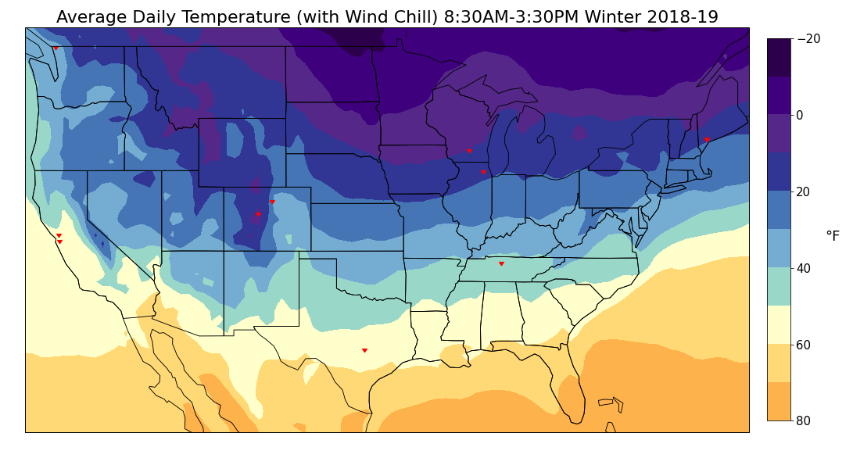
Whatcom County Schools
(20)-(10)F
10-20F
(10)-0F
0-10F
Falmouth PS
Wisconsin Department
of Public Instruction
Portland PS
10-20F
Du Page Waldorf
20-30F
Boulder Valley School District
Golestan Education
Lake County Schools
20-30F
30-40F
San Mateo County Office of Edu
30-40F
50-60F
40-50F
Linden Waldorf
60-70F
50-60F
Austin School District
60-70F

Slide 2
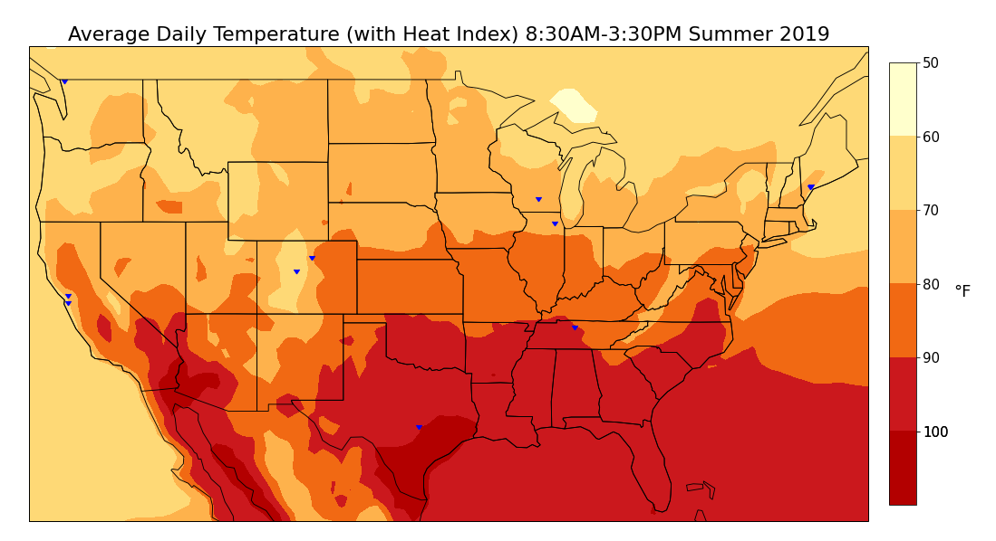
Whatcom County Schools
(20)-(10)F
10-20F
(10)-0F
Wisconsin Department
of Public Instruction
0-10F
Falmouth PS
Portland PS
10-20F
Du Page Waldorf
20-30F
Boulder Valley School District
Golestan Education
Lake County Schools
20-30F
30-40F
San Mateo County Office of Edu
30-40F
50-60F
40-50F
Linden Waldorf
60-70F
50-60F
Austin School District
60-70F

